Slide 1
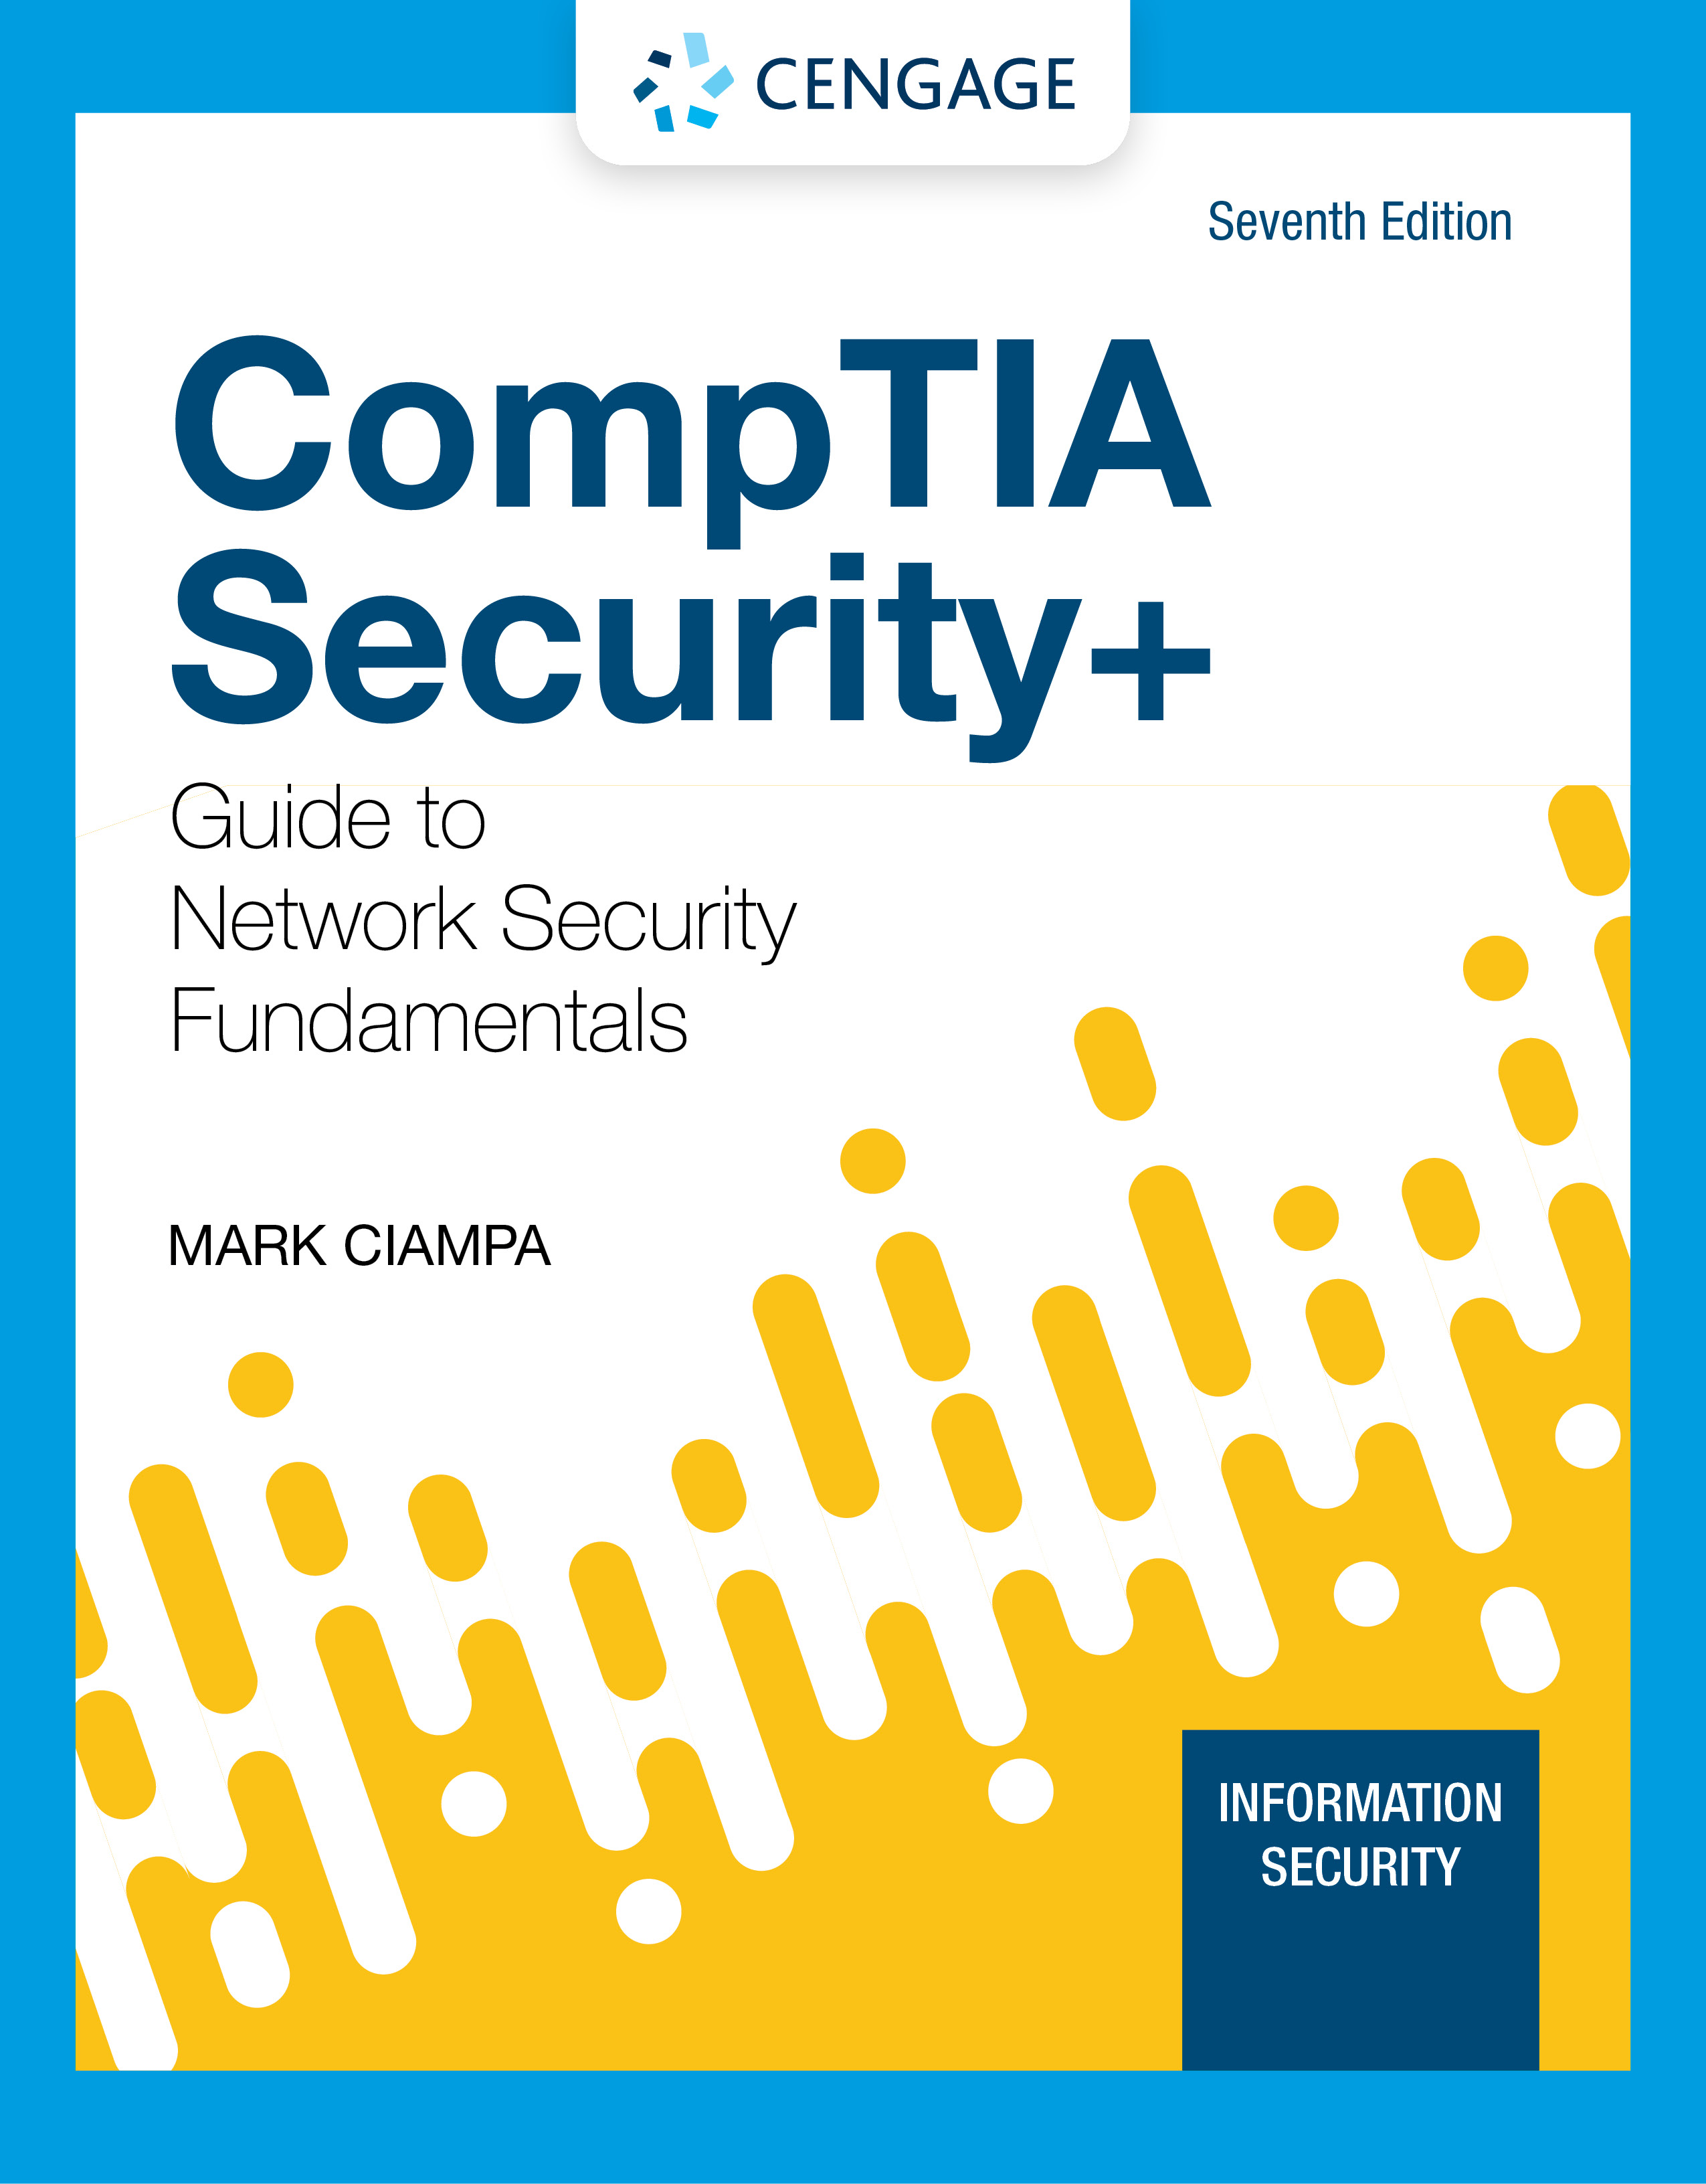
Module 5: Mobile, Embedded, and Specialized Device Security
CompTIA Security+ Guide
to Network Security Fundamentals, 7th Edition

Slide 2
Module Objectives
By the end of this module, you should be able to:
1. List and compare the different types of mobile devices and how they are deployed
2. Explain the ways to secure a mobile device
3. Describe the vulnerabilities and protections of embedded and specialized devices
4. Explain the issues surrounding securing specialized devices

Slide 3
Securing Mobile Devices
Each type of mobile device faces cybersecurity risks
Security professionals can use a variety of techniques and technologies for securing mobile devices

Slide 4
Introduction to Mobile Devices (1 of 7)
Types of Mobile Devices
Tablets are portable computing devices that generally lack a built-in keyboard or mouse
Smartphones have all of the tools of a feature phone plus an OS that allows it to run apps and access the Internet
Wearables are devices that can be worn by the user instead of carried
The most common of these devices is the smart watch
Portable computers are devices that closely resemble standard desktop computers
They are smaller, self-contained devices that can easily be transported from one location to another while running on battery power
A web-based computer contains a limited version of an OS and a web browser with an integrated media player

Slide 5
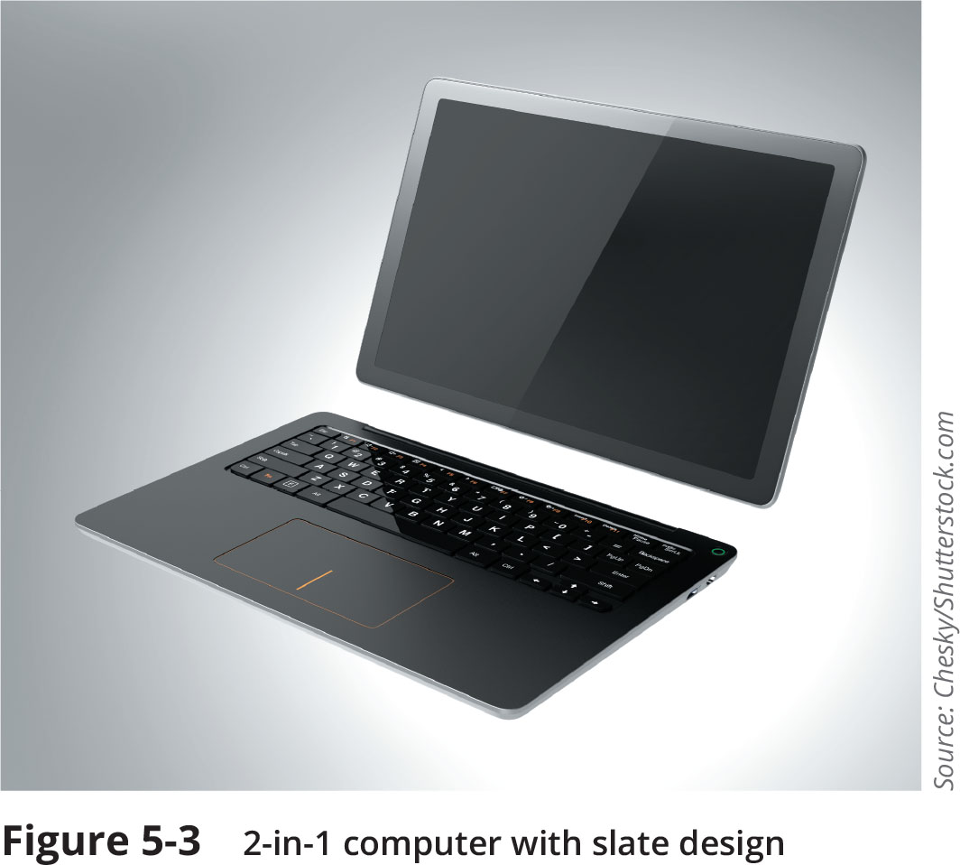
Introduction to Mobile Devices (2 of 7)
Figure 5-3 2-in-1 computer with slate design

Slide 6
Introduction to Mobile Devices (3 of 7)
Core features | Additional features
Small form factor | Global Positioning System (GPS)
Mobile operating system | Microphone and/or digital camera
Wireless data network interface for accessing the Internet, such as Wi-Fi or cellular telephony | Wireless cellular connection for voice communications
Stores or other means of acquiring applications (apps) | Wireless personal area network interfaces such as Bluetooth or near field communications (NFC)
Local nonremovable data storage | Removable storage media
Data synchronization capabilities with a separate computer or remote servers | Support for using the device itself as removable storage for another computing device

Slide 7
Introduction to Mobile Devices (4 of 7)
Mobile Device Connectivity Methods
Cellular – coverage area for a cellular telephony network is divided into cells
Transmitters are connected through a mobile telecommunications switching office (MTSO) that controls all of the transmitters in the cellular network
Wi-Fi – a wireless local area network (WLAN) designed to replace or supplement a wired local area network (LAN)
Infrared – uses light instead of radio frequency (RF) as the communication media
Due to slow speed and other limitations, infrared capabilities are rarely found today
USB connections – these include standard-size connectors, mini connectors, and micro connectors

Slide 8
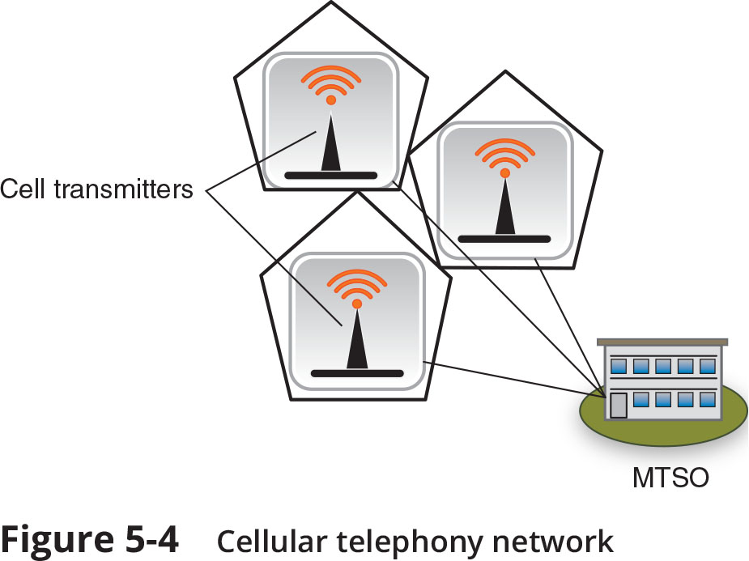
Introduction to Mobile Devices (5 of 7)
Figure 5-4 Cellular telephony network

Slide 9
Introduction to Mobile Devices (6 of 7)
Model Name | Description | Employee actions | Business actions
Bring your own device (BYOD ) | Employees use their own personal mobile devices for business purposes. | Employees have full responsibility for choosing and supporting the device. | This model is popular with smaller companies or those with a temporary staff.
Corporate owned, personally enabled (COPE ) | Employees choose from a selection of company approved devices. | Employees are supplied the device chosen and paid for by the company, but they can also use it for personal activities. | Company decides the level of choice and freedom for employees.
Choose your own device (CYOD ) | Employees choose from a limited selection of approved devices but pay the upfront cost of the device while the business owns the contract. | Employees are offered a suite of choices that the company has approved for security, reliability, and durability. | Company often provides a stipend to pay monthly fees to wireless carrier
Virtual desktop infrastructure (VDI ) | Stores sensitive applications and data on a remote server accessed through a smartphone | Users can customize the display of data as if the data were residing on their own mobile device. | Enterprise can centrally protect and manage apps and data on server instead of distributing to smartphones.
Corporate owned | The device is purchased and owned by the enterprise. | Employees use the phone only for company-related business. | Enterprise is responsible for all aspects of the device.

Slide 10
Introduction to Mobile Devices (7 of 7)
Enterprise Deployment Models
Benefits of BYOD, COPE, and CYOD models include:
Management flexibility
Cost savings
Increased employee performance
Simplified IT infrastructure
Reduced internal service
User benefits include:
Choice of device
Choice of carrier
Convenience

Slide 11
Mobile Device Risks (1 of 3)
Security risks associated with using mobile devices include mobile device vulnerabilities, connection vulnerabilities, and accessing untrusted content
Mobile Device Vulnerabilities
Physical security – mobile devices are frequently lost or stolen
Limited updates – security patches and updates for mobile OSs are distributed through firmware over-the-air (OTA) updates
Location tracking – mobile devices with GPS capabilities typically support geolocation
Mobile devices using geolocation are at increased risk of targeted physical attacks
A related risk is GSP tagging which is adding geographical identification data to media
Unauthorized recording – by infecting a device with malware, a threat actor can spy on an unsuspecting victim and record conversations or videos

Slide 12
Mobile Device Risks (2 of 3)
Connection Vulnerabilities
See Table 5-4 on the following slide
Accessing Untrusted Content
Users can circumvent the built-in installation limitation on their smartphone (called jailbreaking on Apple iOS or rooting on Android devices) to download from an unofficial third-party app store (called sideloading)
Untrusted content can invade mobile devices through SMS, MMS, and RCS text messaging
Mobile devices can access untrusted content using QR codes
An attacker can create an advertisement listing a reputable website but include a QR code that contains a malicious URL

Slide 13
Mobile Device Risks (3 of 3)
Name | Description | Vulnerability
Tethering | A mobile device with an active Internet connection can be used to share that connection with other mobile devices through Bluetooth or Wi-Fi. | An unsecured mobile device may infect other tethered mobile devices or the corporate network.
USB On-the-Go (OTG) | An OTG mobile device with a USB connection can function as either a host (to which other devices may be connected such as a USB flash drive) for external media access or as a peripheral (such as a mass storage device) to another host. | Connecting a malicious flash drive infected with malware to a mobile device could result in an infection, just as using a device as a peripheral while connected to an infected computer could allow malware to be sent to the device.
Malicious USB cable | A USB cable could be embedded with a Wi-Fi controller that can receive commands from a nearby device to send malicious commands to the connected mobile device. | The device will recognize the cable as a Human Interface Device (similar to a mouse or keyboard), giving the attacker enough permissions to exploit the system.
Hotspots | A hotspot is a location where users can access the Internet with a wireless signal. | Because public hotspots are beyond the control of the organization, attackers can eavesdrop on the data transmissions and view sensitive information.

Slide 14
Protecting Mobile Devices (1 of 6)
Device Configuration
Several configurations should be considered when setting up a mobile device for use
Use Strong Authentication
Verifying that the authentic user of a device involves requiring a strong passcode and restricting unauthorized users with a screen lock
Options include using:
A passcode
A PIN
A fingerprint
A pattern connecting dots to unlock the device
A screen lock prevents the mobile device from being accessed until the user enters the correct passcode

Slide 15
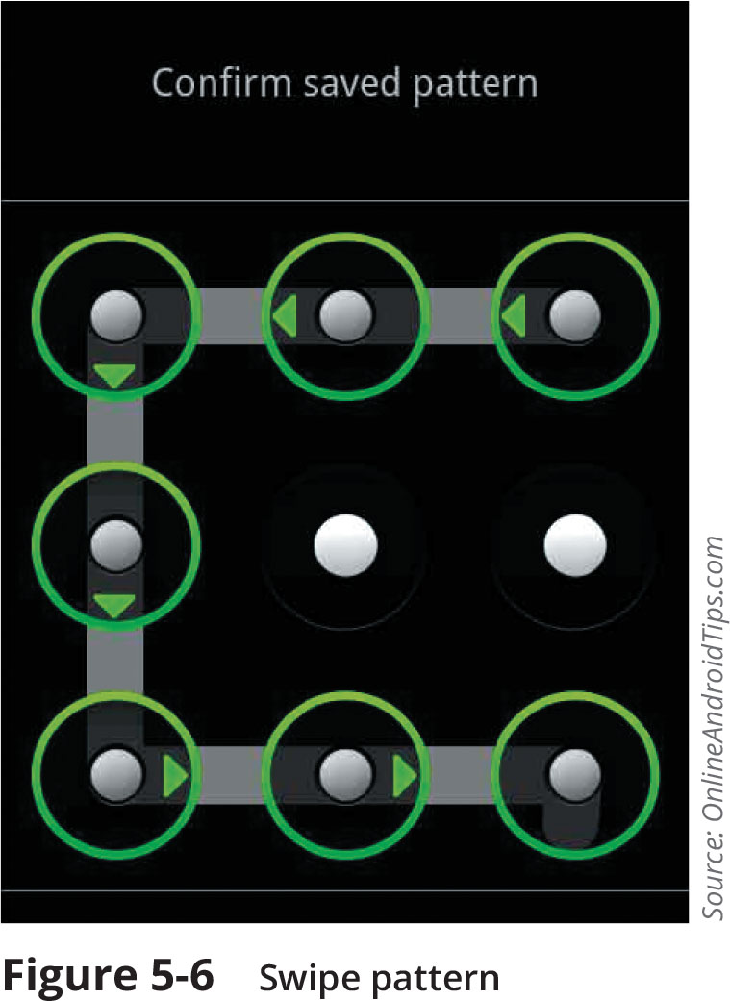
Protecting Mobile Devices (2 of 6)
Figure 5-6 Swipe pattern

Slide 16
Protecting Mobile Devices (3 of 6)
Device Configuration (continued)
Manage Encryption
Early versions of both mobile OSs encrypt all user data on their mobile devices (full disk encryption) by default when the device is locked
Mobile device data can still be accessed through remote data-at-rest
Segment Storage
Storage segmentation separates business data from personal data on mobile devices
Users can apply containerization, or separating storage into business and personal “containers”
It helps companies avoid data ownership privacy issues and legal concerns regarding a user’s personal data stored on the device

Slide 17
Protecting Mobile Devices (4 of 6)
Device Configuration (continued)
Enable Loss or Theft Services
If a lost or stolen device cannot be located, it may be necessary to perform a remote wipe, which will erase sensitive data stored on the mobile device
To reduce the risk of theft or loss, users should:
Keep the mobile device out of sight when traveling in a high-risk area
Avoid becoming distracted by what is on the device
When holding a device, use both hands to make it more difficult for a thief to snatch
Do not use the device on escalators or near transit train doors
Use a less conspicuous color for headphone cords
Do not resist or chase a thief if they steal your device

Slide 18
Protecting Mobile Devices (5 of 6)
Security feature | Explanation
Alarm | The device can generate an alarm even if it is on mute.
Last known location | If the battery is charged to less than a specific percentage, the device’s last known location can be indicated on an online map.
Locate | The current location of the device can be pinpointed on a map through the device’s GPS.
Remote lockout | The mobile device can be remotely locked and a custom message sent that is displayed on the login screen.
Thief picture | Thieves who enter an incorrect passcode three times will have their picture taken through the device’s on-board camera and emailed to the owner.

Slide 19
Protecting Mobile Devices (6 of 6)
Mobile Management Tools
Mobile Device Management (MDM) tools allow a device to be managed remotely by an organization
Mobile Application Management (MAM) covers application management, which comprises the tools and services responsible for distributing and controlling access to apps
Mobile Content Management (MCM) supports the creation and subsequent editing and modification of digital content by multiple employees
Unified Endpoint Management (UEM) is a group or class of software tools with a single management interface for mobile devices as well as computer devices
It provides capabilities for managing and securing mobile devices, applications, and content

Slide 20
Knowledge Check Activity 1
Which enterprise deployment model of mobile devices stores sensitive applications and data on a remote server that you can access through a smartphone?
a. VDI
b. CYOD
c. BYOD
d. COPE

Slide 21
Knowledge Check Activity 1: Answer
Which enterprise deployment model of mobile devices stores sensitive applications and data on a remote server that you can access through a smartphone?
Answer: a. VDI
A virtual desktop infrastructure (VDI) uses servers at the employer’s site or at a cloud provider to deliver applications, data, and entire OSs, to a mobile device app or Web browser.

Slide 22
Knowledge Check Activity 2
Which mobile management tool provides capabilities for managing and securing mobile devices, applications, and content?
a. MDM
b. MCM
c. UEM
d. MAM

Slide 23
Knowledge Check Activity 2: Answer
Which mobile management tool provides capabilities for managing and securing mobile devices, applications, and content?
Answer: c. UEM
Unified Endpoint Management (UEM) supports all of the capabilities of MDM, MAM, and MCM. It provides a single management interface for mobile devices.

Slide 24
Embedded Systems and Specialized Devices
Computing capabilities can be integrated into appliances and other devices
An embedded system is computer hardware and software contained within a larger system designed for a specific function
These devices can pose security risks

Slide 25
Types of Devices (1 of 7)
Categories of embedded and specialized devices include the hardware and software that can be used to create these devices, specialized systems, industrial systems, other devices, and IoT devices
Hardware and Software
One of the most common hardware components is the Raspberry Pi, which is a low-cost, credit-card-sized computer motherboard
It can perform almost any task that a standard computer can and can be used to control a specialized device
A field-programmable gate array (FPGA) is a hardware “chip” that can be programmed by the user to carry out one or more logical operations
A system on a chip (SoC) combines all the required electronic circuits of the various computer components on a single chip
SoCs often use a real-time operating system (RTOS)

Slide 26
Types of Devices (2 of 7)
Specialized Systems
Digital smart meters are used to measure the amount of utilities consumed
Smart meters have several advantages over analog meters (see Table 5-8 on the following slide)
Other specialized systems include medical systems, aircraft, and vehicles
Embedded systems in cars use sonar, radar, and laser emitters to control brakes, steering, and the throttle
Industrial Systems
Industrial control systems (ICSs) in local or at remote locations collect, monitor, and process real-time data so that machines can directly control devices such as valves, pumps, and motors without human intervention
ICSs are managed by supervisory control and data acquisition (SCADA) systems

Slide 27
Types of Devices (3 of 7)
Action | Analog meter | Smart meter
Meter readings | Employee must visit the dwelling each month to read the meter. | Meter readings are transmitted daily, hourly, or even by the minute to the utility company.
Servicing | Annual servicing is required in order to maintain accuracy. | Battery replacement every 20 years.
Tamper protection | Data must be analyzed over long periods to identify anomalies. | Can alert utility in the event of tampering or theft.
Emergency communication | None available | Transmits “last gasp” notification of a problem to utility company.

Slide 28
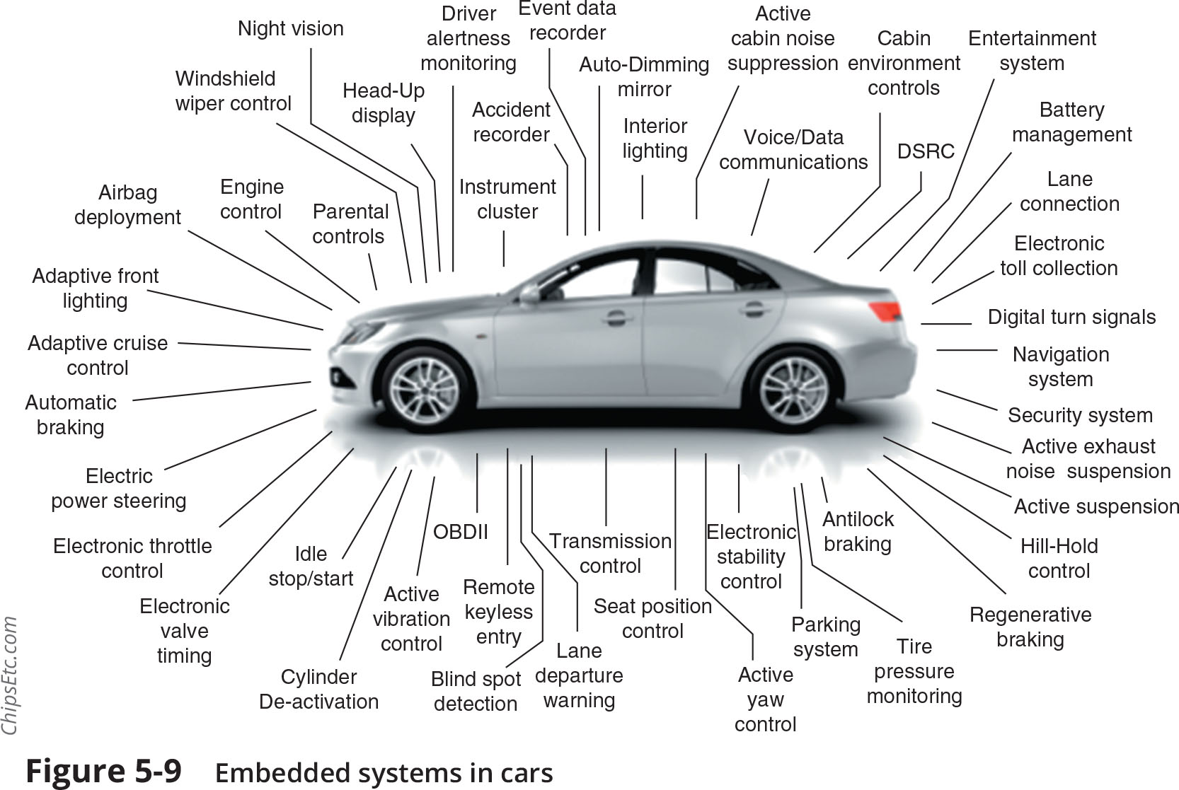
Types of Devices (4 of 7)
Figure 5-9 Embedded systems in cars

Slide 29
Types of Devices (5 of 7)
Other Specialized Systems
Other examples of specialized systems include heating, ventilation, and air conditioning (HVAC) environmental systems
A multifunctional printer (MFP) combines the functions of a printer, copier, scanner, and fax machine
An unmanned aerial vehicle (UAV) commonly known as a drone, is an aircraft without a human pilot on board to control its flight
They are commonly used for policing and surveillance, product deliveries, aerial photography, infrastructure inspections, and drone racing

Slide 30
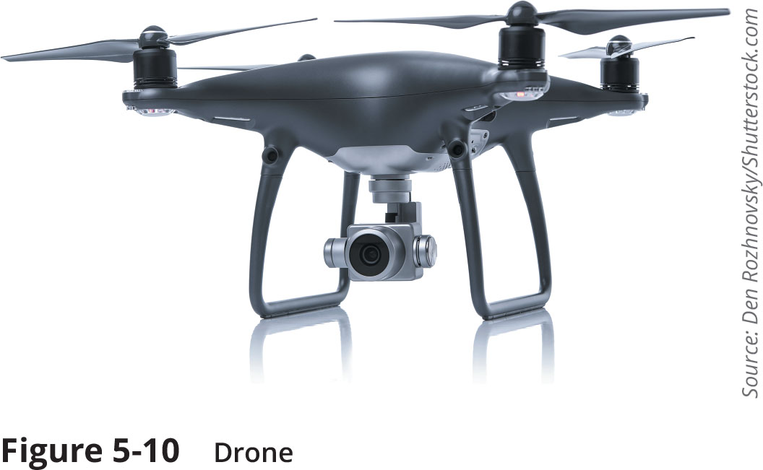
Types of Devices (6 of 7)
Figure 5-10 Drone

Slide 31
Types of Devices (7 of 7)
Internet of Things
Internet of Things (IoT) is connecting any device to the Internet for the purpose of sending and receiving data to be acted upon
IoT devices include wearable technology as well as every home automation items such as thermostats, coffee makers, tire sensors, slow cookers, keyless entry systems, washing machines, electric toothbrushes, headphones, and light bulbs
Body area networks (BAN) is a network system of IoT devices in close proximity to a person’s body that cooperate for the benefit of the user
Autonomous body sensor network (ABSN) introduces actuators in addition to the sensors so that immediate effects can be made on the human body

Slide 32
Security Issues Table (1 of 2)
Constraint | Explanation
Power | To prolong battery life, devices and systems are optimized to draw very low levels of power and thus lack the ability to perform strong security measures.
Compute | Due to their size, small devices typically possess low processing capabilities, which restricts complex and comprehensive security measures.
Network | To simplify connecting a device to a network, many device designers support network protocols that lack advanced security features.
Cryptography | Encryption and decryption are resource-intensive tasks that require significant processing and storage capacities that these devices lack.
Inability to patch | Few, if any, devices have been designed with the capacity for being updated to address exposed security vulnerabilities.
Authentication | To keep costs at a minimum, most devices lack authentication features.
Range | Not all devices have long-range capabilities to access remote security updates.
Cost | Most developers are concerned primarily with making products as inexpensive as possible, which means leaving out all security protections.
Implied trust | Many devices are designed without any security features but operate on an “implied trust” basis that assumes all other devices or users can be trusted.
Weak defaults | User names (such as “root,” “admin,” and “support”) and passwords (“admin,” “888888,” “default,” “123456,” “54321,” and even “password”) for accessing devices are often simple and well known.

Slide 33
Security Issues (2 of 2)
Over several years, many industry-led initiatives have attempted to address security vulnerabilities in IoT and embedded devices
The initiatives were scattered and did not represent a comprehensive solution to the problem
Governments have begun to propose or enact legislation to require stronger security on embedded systems and specialized devices
The Internet of Things (IoT) Cybersecurity Improvement Act of 2019 was legislation introduced in the U.S. Senate in May 2019
California and Oregon passed state laws addressing IoT security that went into effect in January 2020
Requires that connected devices be equipped with “reasonable security features” appropriate for the nature and function of the device and the information the device collects, contains, or transmits

Slide 34
Knowledge Check Activity 3
Which of the following is used to manage industrial control systems (ICSs)?
a. SoC
b. SCADA
c. Real-time OS
d. Embedded system

Slide 35
Knowledge Check Activity 3: Answer
Which of the following is used to manage industrial control systems (ICSs)?
Answer: b. SCADA
Supervisory control and data acquisition (SCADA) systems are used to manage ICSs and are crucial in maintaining efficiency and reducing downtime.

Slide 36
Self-Assessment
Rate your competence of the following module objectives on a scale of 1 to 5 where 5 indicates you have full confidence in your competence of that objective and 1 indicates you have very little to no confidence in your competence of that objective. If you self-score less than 4 you should consider reviewing the module and related exercises:
1. List and compare the different types of mobile devices and how they are deployed
2. Explain the ways to secure a mobile device
3. Describe the vulnerabilities and protections of embedded and specialized devices
4. Explain the issues surrounding securing specialized devices

Slide 37
Summary (1 of 2)
There are several types of mobile devices: tablet computers, smartphones, and wearable technology devices are a few
Portable computers are devices that closely resemble standard desktop computers
Connectivity methods used to connect mobile devices to networks include cellular telephony, which divides the coverage area into cells
It is not always feasible to require an employee to carry a company-owned smartphone along with a personal cell phone
Bring your own device (BYOD) allows users to use their own personal mobile devices for business purposes
Choose your own device (CYOD) gives employees a limited selection of approved devices, though the employee pays the upfront cost of the device while the business owns the contract

Slide 38
Summary (2 of 2)
Several risks are associated with using mobile devices
Mobile devices have the ability to access untrusted content that other types of computing devices generally do not have
Users should consider security when initially setting up a mobile device
Several support tools can facilitate the management of mobile devices in the enterprise
Mobile device management (MDM) tools allow a device to be managed remotely by an organization
Mobile application management (MAM) covers application management
A mobile content management (MCM) system provides content management to mobile devices used by employees in an enterprise
Embedded and specialized devices can be classified into several categories
Security in embedded systems is lacking and can result in a wide range of attacks

